Slide 1
Job Tracking.

Slide 2
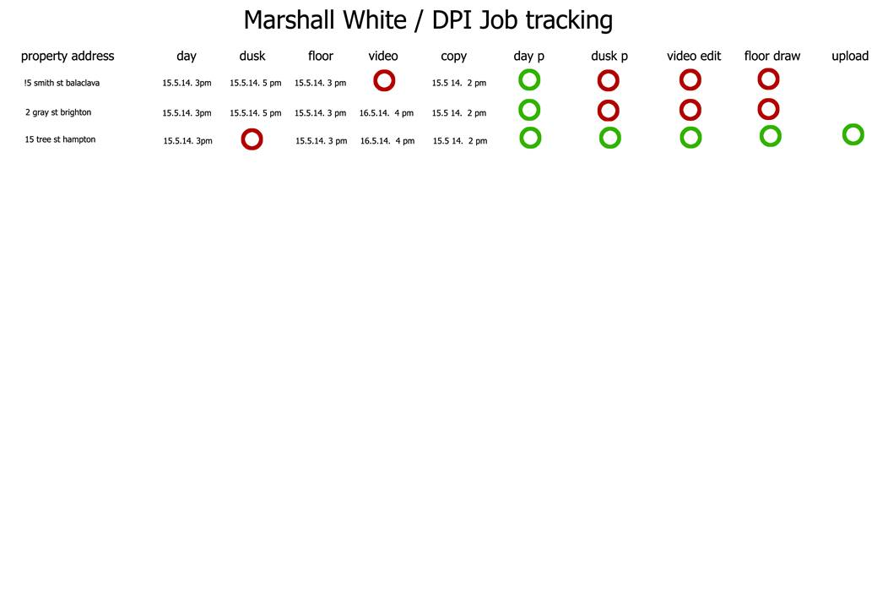
Clients original request.
1. the ct order will generate an entry listed as an address
2. when the jobs are dragged from the staging calendar, the form will take the calendar entry date and time
3. when the dpi staff responsible for the processing or editing, have completed the job, they will edit the form and update.
4. the form needs to update every 5 minutes or so
5. if the address does not have a product ordered , a red button appears ie no video ordered mean a red button in place of the date and time
6. the list of address must be in chronological order
7. there needs to be a search function available

Slide 3
Explanation
Order is received by CT-DPI email, and Events are created in the staging calendar. These are ‘Jobs’, which will have inside the description field an OrderId, and ProductGroupID and Name.
During the email receive process, we will create a new step to Create the record in Job table.
The scheduler (user) will move these events using OMS to individual calendars.
I will write a SQL routine which runs every 5 mins to query the Events table for OrderId and ProductID and I will insert these into the JobEvents table.
This Job tracking from will read off the Job and Job events table, to display which ProductGroup has been ordered and what time the Event is scheduled for, for a specific address. I will write this SP.
The internal users have the ability to upload Photos, or words (copywriting) once the job has been done and mark as completed.
Photos will go into Job Attachments
Copy will go into JobCopy

Slide 4
Eg.
Select PG.Name as Service,
J.Title,
LTRIM(RIGHT(CONVERT(VARCHAR(19),JE.STARTDATE),8))
from Job J inner join [dbo].[JobEvents] JE on J.row_Id = JE.Job_Id inner join ProductGroups PG on JE.ProductGroupId = PG.Row_Id

Slide 5
I have created some tables.
Job -- Where we would store the Jobs
JobAttachments -- Where the uploads will go for Jobs
JobCopy -- Where the copywriting uploads will go
JobCopyType -- The type field for Copywriting uploads.
JobEvents -- The allocated Events of the Jobs
JobStatus -- The status of the Job and storing changes to the Status.

Slide 6
Job Tracking
The Job tracking form is primarily for External Users (Clients) to see the status of their Orders. External Users will not have any edit functions, just read only of the status’ in the list and constrained to the orders that they have sent.
Internal Users, have the ability to interact with the list, update status’ and also upload the digital assets that have been produced as a result of the job.

Slide 7

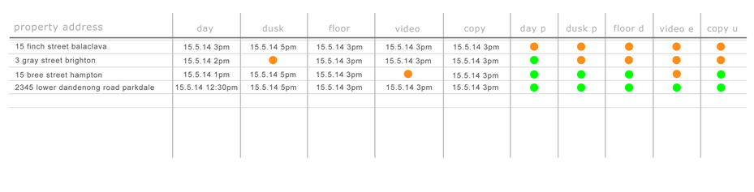
Contacts
Job Tracking
Home
Companies
Products
Contacts
Orders
Scheduler
Job Tracking
All Jobs
My Jobs

Slide 8

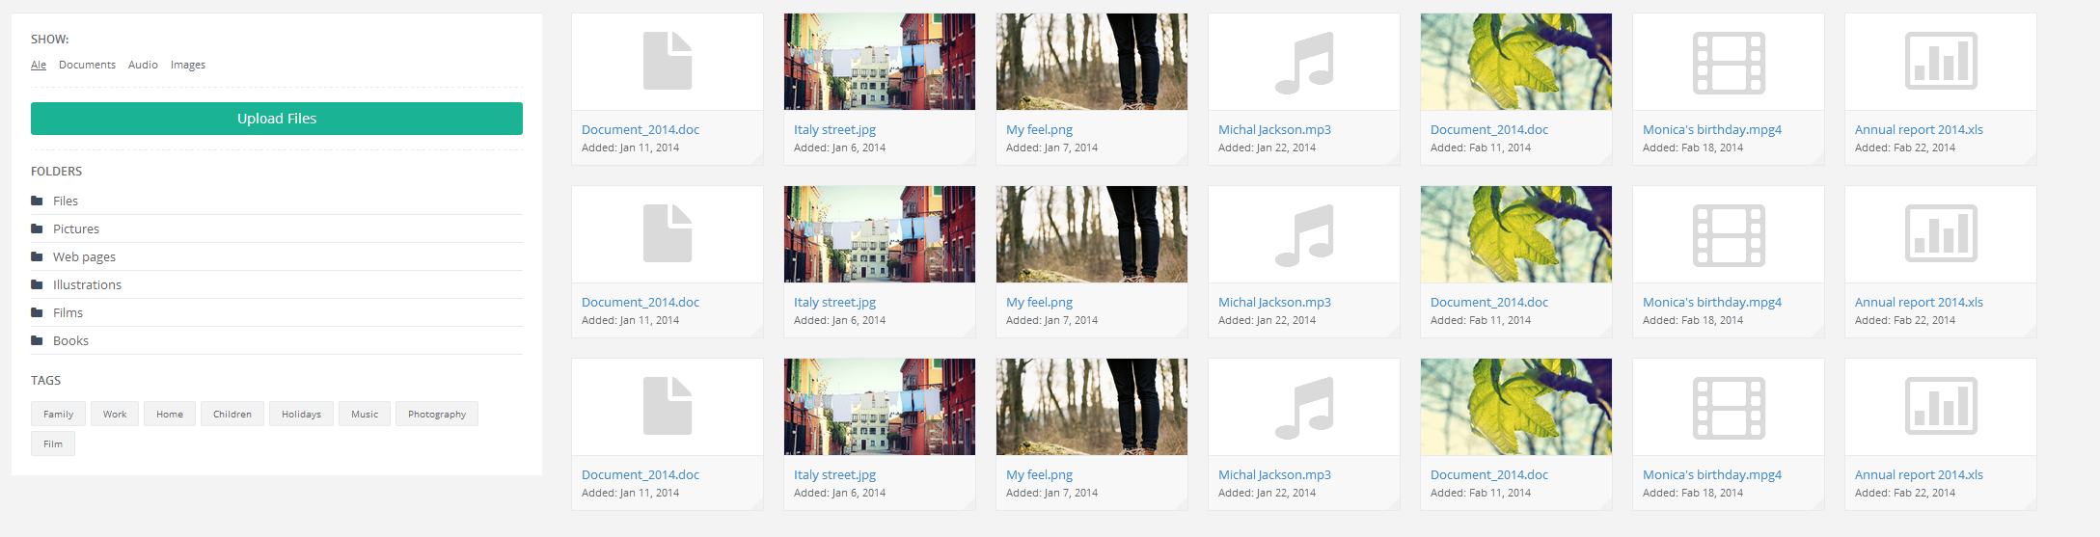
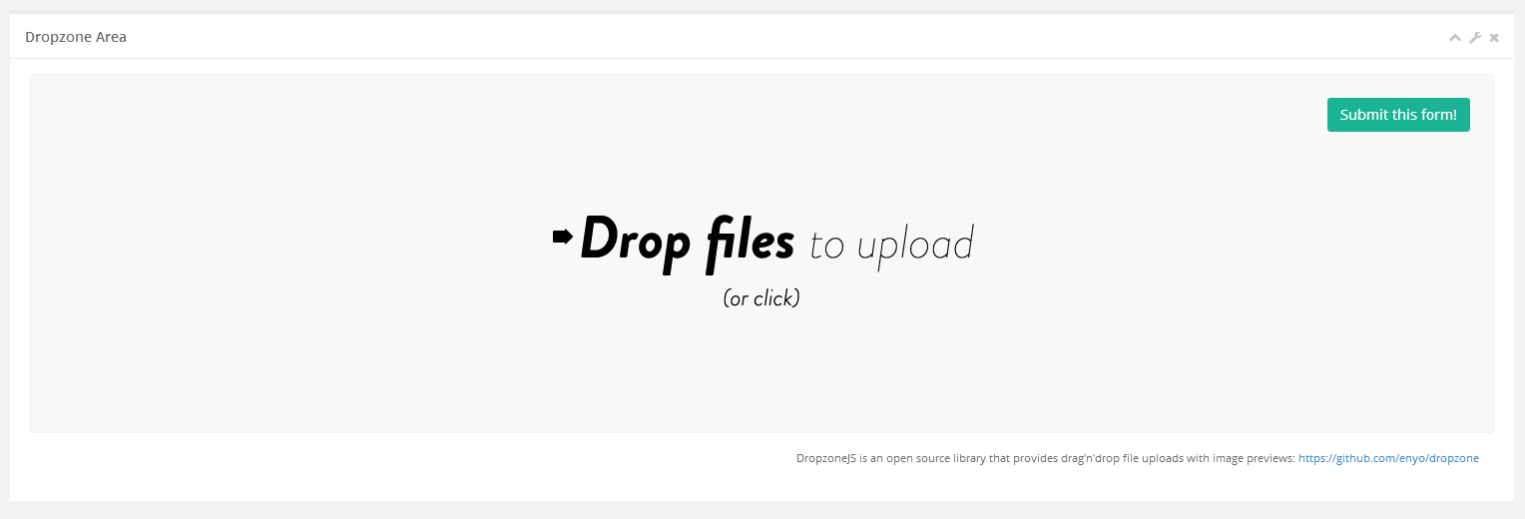
Internal User
When clicking on the icon for photography (day/dusk)
It should allow the user to upload pictures and mark this activity
Off as complete.
15 Finch Street Balaclava: Photography - Day
Status
Complete

Slide 9
Create a new table to store the attachments. JobAttachments Row_Id int pk Order_Id int fk to t_order.row_id Org_Id int fk to organisation.row_id FileName varchar(255) FileExtension varchar(5) FileSize int File image Type varchar(100) values Photo Day, Photo Dusk, Video, Copywriting, Floorplan Folder varchar(100) Created datetime CreatedBy int Updated datetime UpdatedBy int

Slide 10
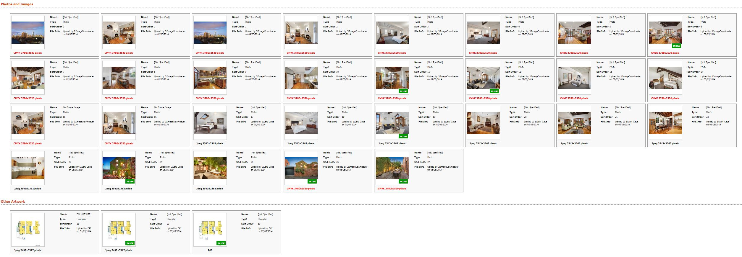
This is a gallery of images that have been uploaded. Divided by Type. This is how campaigntrack does it.

Slide 11
Create a new table. This will store the content if the service was for copywriting. OrderContent Row_Id int pk Order_Id int fk to t_order.row_id Org_Id int fk to organisation.row_id AdCopySub_Title vachar(max) AdCopySub_Body vachar(max) Signboard_Title vachar(max) Signboard_Body vachar(max) Brochure_Title vachar(max) Brochure_Copy vachar(max) AdCopyMetro_Title vachar(max) AdCopyMetro_Body vachar(max) Other_Title vachar(max) Other_Body varchar(max)

Slide 12
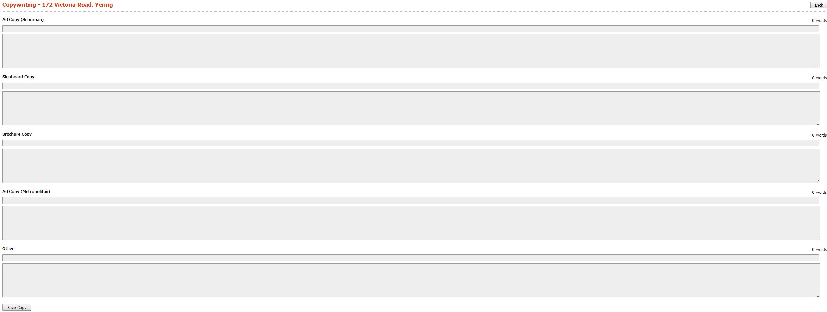
When clicking on the icon for copywriting
It should allow the user to upload content and mark this activity
Off as complete.
15 Finch Street Balaclava: Copywriting
Status
Complete

Slide 13
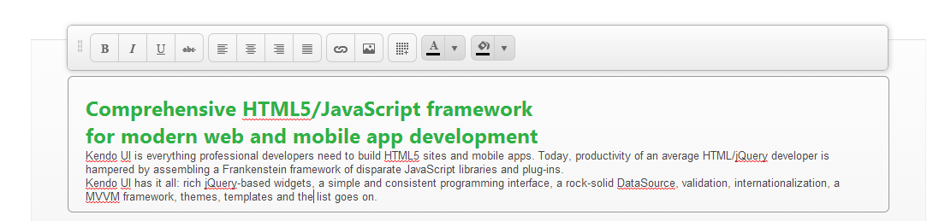
We should use the telrik inline editor for each of the content boxes.
http://demos.telerik.com/kendo-ui/editor/inline-editing

Slide 14
Revised Job Tracking

Slide 15
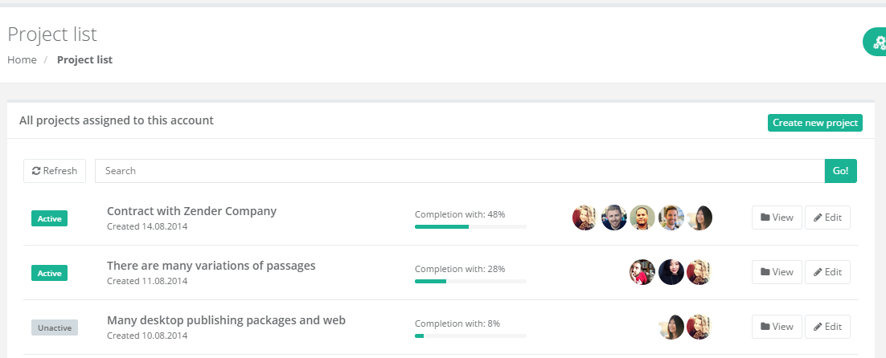
I think we try and keep this as aligned as possible to this structure to speed the process with some changes to meet the clients original requirements.

Slide 16
Search will search against title. If the user is external user, it will return only those associated to their company. If the user is internal user, it will be all related to their organisation.

Slide 17
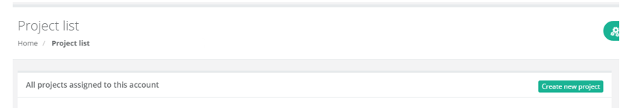
1. Replace the term “Project” with Job. 2. Users will not need the ability to create a job, this will initially come via the CT e-mail process and New Order Process.

Slide 18
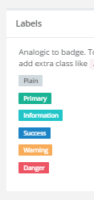
Job.Title
% will be calculated as % of total services which
Have been marked as complete.
So if there are 2 services and 1 is done, then 50%
External Users will
Not see these buttons,
Only internal users.
We re are going to keep
these icons but instead of images of users they will be tags representing the services
“Services” = “Product Group”
Job.Status
Job.Required_date
Display as “Requested for: 12/12/2004”

Slide 19
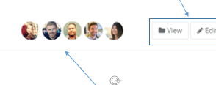

On mouse over each specific tag, display the specifics of the service.
Day Photography
Fri 21st March, 2014
12:00 pm to 13:30pm

Slide 20
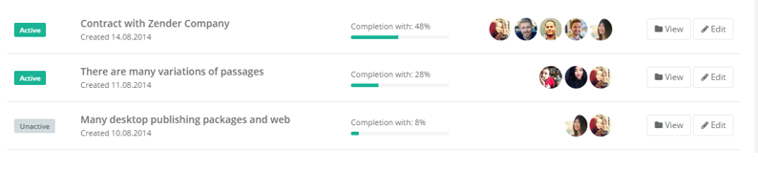
JobStatus will come from JobStatus’s table and the colour of buttons will be derived from this table.

Slide 21
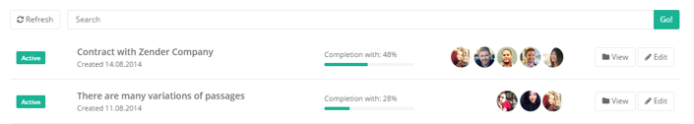
If a user clicks a Job, the grid will expand and display the specific times, and status for each Job. It contract if the use clicks again.
Service | Booking | Status
Day Photography | 12/12/2015 14:50 | Complete
Dusk Photography | 12/12/2015 14:50 | Confirmed
Video | 12/12/2015 14:50 | Confirmed
Floor plan | 12/12/2015 14:50 | Confirmed

Slide 22
Job Detail form.
This will only be available to Internal Users and Administrators.

Slide 23
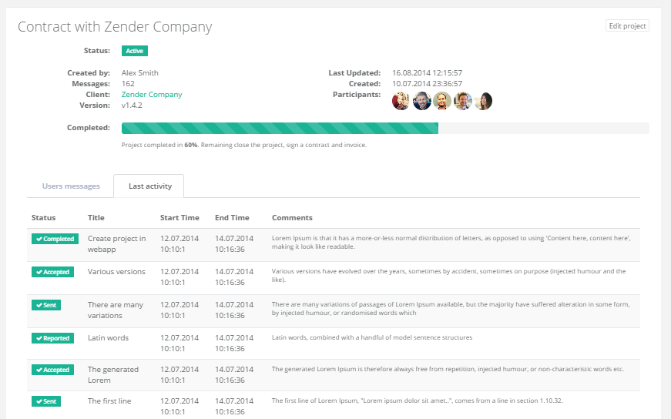
Internal users and, administrators will have access to this view.
Events
Gallery
Copywriting

Slide 24
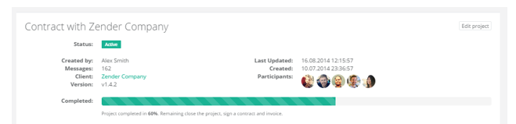
Title
Product Groups
Status
Services:
We don’t need Version.
We don’t need this to be so big, this completed form.

Slide 25
The following procedure has been created to return the Jobs list.
Alter Procedure [SelectJobs]
(@ORG_ID int, @USER_ID int, @USER_TYPE VARCHAR(100), @USER_COMPANY_ID INT, @SearchValue Varchar(1000))
exec [SelectJobs] 825, 1, 'Client', 14026, ‘101 Seaford’
exec [SelectJobs] 825, 1, 'Staff', 14026, 'East'

Slide 26
Job Detail
Gallery

Slide 27
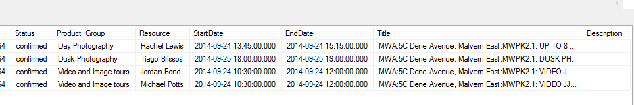
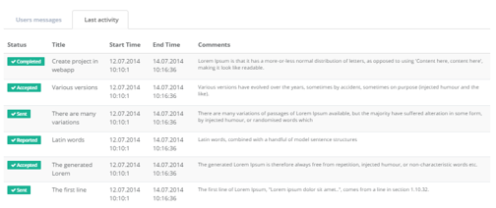
This tab will be called Events and come from JobEvents table. 1. We will include 2 additional fields. Product Group, and User. 2. The user will be able to update the status to say this has been completed. This data is available from the SelectJobs procedure.
Events
Gallery
Copywriting

Slide 28
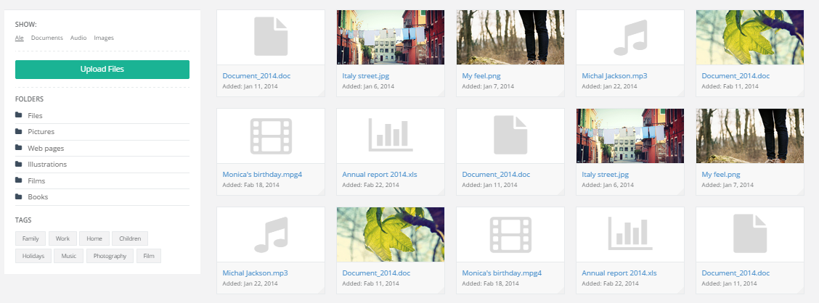
The Internal users must be able to upload attachments for the photography services for Day & Dusk, Areal and Floorplan in a gallery section.
Events
Gallery
Copywriting

Slide 29
1. The image need to be able to be uploaded and downloaded. 2. The images need to be able to be put in folders according to whether they are Day, Dusk, Aeral or Floor plans, etc. I have provided an SP to return these folders. on the next slide. 3. Ideally we should have put these images in amazon s3 rather than the db.

Slide 30
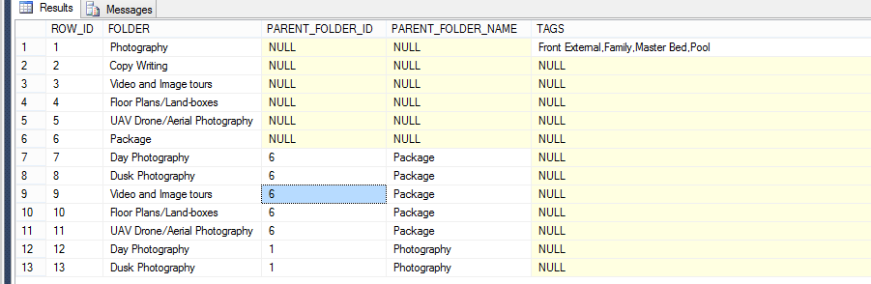
I have included an SP which will return you the folders to be included within the gallery. The SP returns hierarchical folders, including any tags that might be available to apply to the attachments.
SelectJobAttachmentFolders (@ORG_ID int, @USER_ID int, @USER_TYPE VARCHAR(100), @USER_COMPANY_ID INT)

Slide 31
I have included the following SP’s
InsertJobAttachment (@ORG_ID int, @USER_ID int, @USER_TYPE VARCHAR(100), @USER_COMPANY_ID INT, @Job_Id int, @FileName Varchar(100), @FileExtension Varchar(100), @FileSize int, @File varbinary(max), @GroupType varchar(100), @Tags varchar(max), @Folder varchar(100))
UpdateJobAttachment (@ORG_ID int, @USER_ID int, @USER_TYPE VARCHAR(100), @USER_COMPANY_ID INT, @JobAttachmentId int, @FileName Varchar(100), @FileExtension Varchar(100), @FileSize int, @File varbinary(max), @GroupType varchar(100), @Tags varchar(max), @Folder varchar(100), @Selected bit)
DeleteJobAttachment (@ORG_ID int, @USER_ID int, @USER_TYPE VARCHAR(100), @USER_COMPANY_ID INT, @JobAttachmentId int)

Slide 32
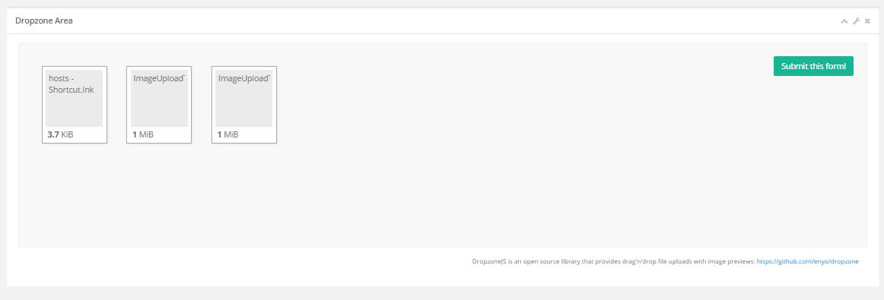
The framework has a drag and drop function, and Kendo UI also has an async upload function included in the Kendo UI framework.

Slide 33
Job Detail
Copywriting.

Slide 34
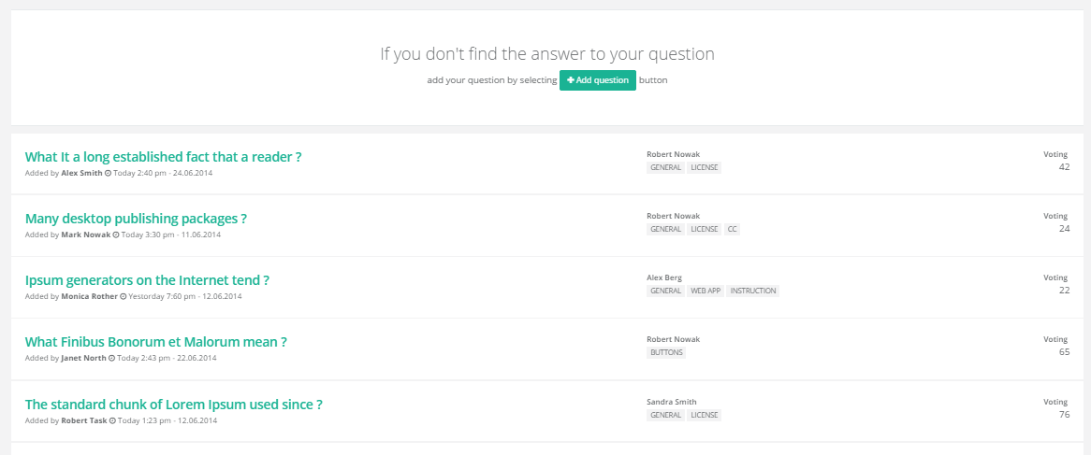
1. Use the FAQ section in the bootstrap framework as the initial design. 2. It should allow the user to enter new, edit, delete.
Events
Gallery
Copywriting
Voice api

Slide 35
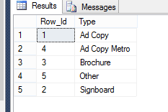
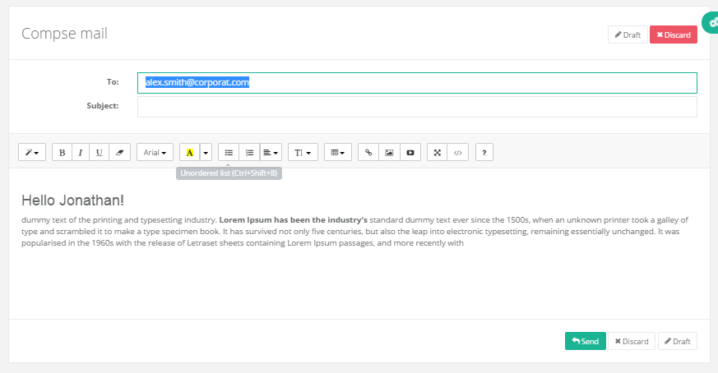
For new/edit, allow creation /edit. using template editor. 1. Use the following SP to get the Types [SelectJobCopyTypes] (@ORG_ID int, @USER_ID int, @USER_TYPE VARCHAR(100), @USER_COMPANY_ID INT) eg. exec SelectJobCopyTypes 825, 1, ‘Staff', 14026
Type
Title
Title Word Count: 99 Body Word Count: 1000

Slide 36
The following SP’s have been created for Job Copy.
SelectJobCopy (@ORG_ID int, @USER_ID int, @USER_TYPE VARCHAR(100), @USER_COMPANY_ID INT, @JOB_ID INT)
InsertJobCopy (@ORG_ID int, @USER_ID int, @USER_TYPE VARCHAR(100), @USER_COMPANY_ID INT, @Job_Id int, @Type_Id int, @Title varchar(max), @TitleWordCount int, @Body varchar(max), @BodyWordCount int, @Status varchar(100))
UpdateJobCopy (@ORG_ID int, @USER_ID int, @USER_TYPE VARCHAR(100), @USER_COMPANY_ID INT, @JOB_COPY_ID int, @TYPE_ID int, @Title varchar(max), @TitleWordCount int, @Body varchar(max), @BodyWordCount int, @Status varchar(100), @isDeleted bit)
[DeleteJobCopy] (@ORG_ID int, @USER_ID int, @USER_TYPE VARCHAR(100), @USER_COMPANY_ID INT, @JOB_COPY_ID int)

